Slide 1
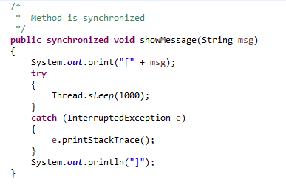
Java synchronized method
If there is no synchronization, output will be inconsistent.
If there is synchronization, output will be consistent.
When Race condition occur, we will get inconsistent result.
If you declare any method as synchronized, it is known as synchronized method.
Synchronized method is used to lock an object for any shared resource.
When a thread invokes a synchronized method, it automatically acquires the lock for that object and releases it when the thread completes its task.
Using Synchronized methods is a way to accomplish synchronization.
Synchronized method will be available to only one thread at a time.

